Slide 1
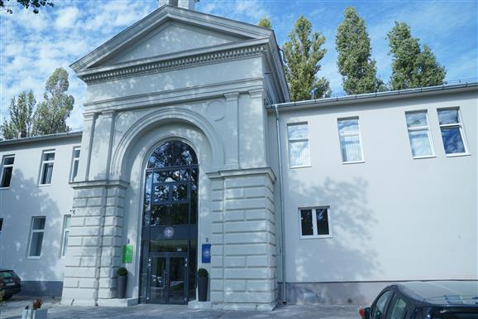

MOT PROTÉZIS KEREKASZTAL
A térdprotézisek aktuális kérdései BEK Akadémia
Budapest, 2023.11.11.
CSONTPÓTLÁS ÉS CONSTRAINT ÖSSZEFÜGGÉSEI TÉRD REVÍZIÓBAN
Udvarhelyi Iván
Uzsoki Kórház, Budapest

Slide 2
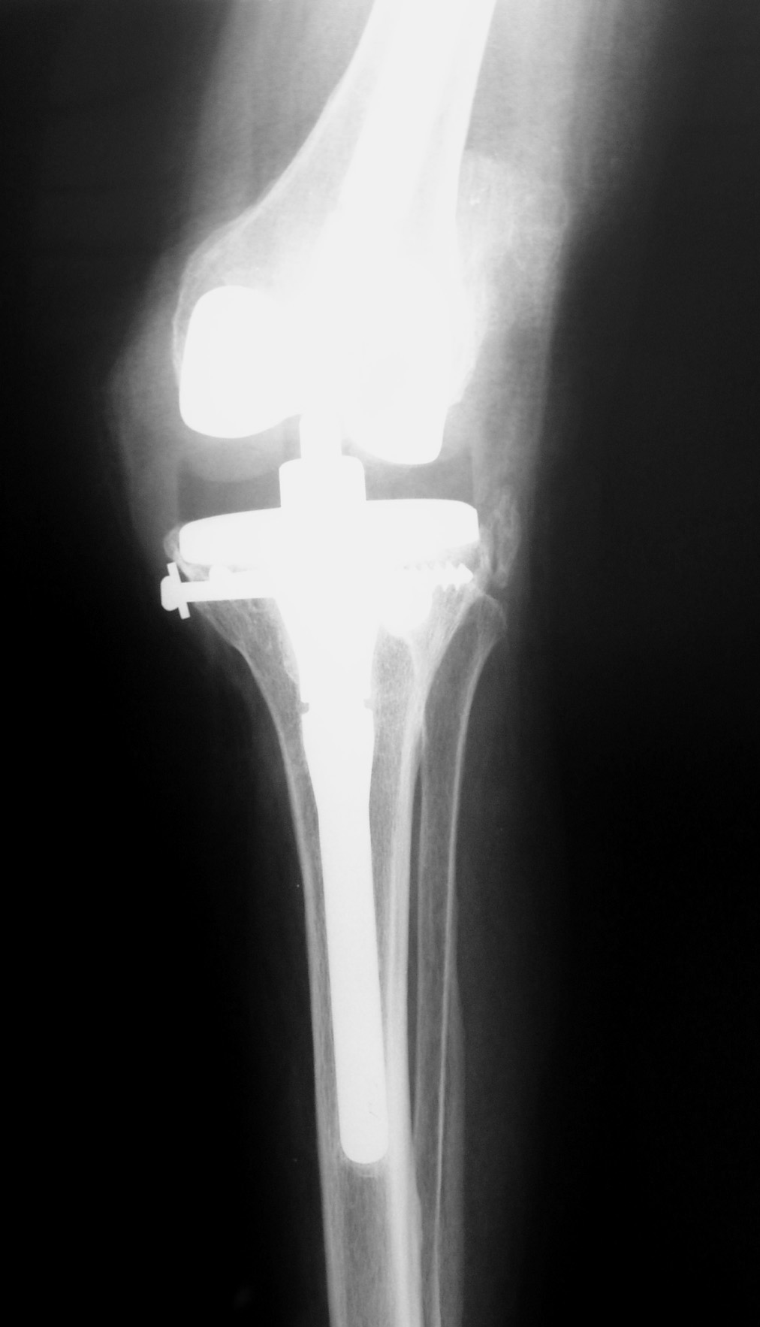
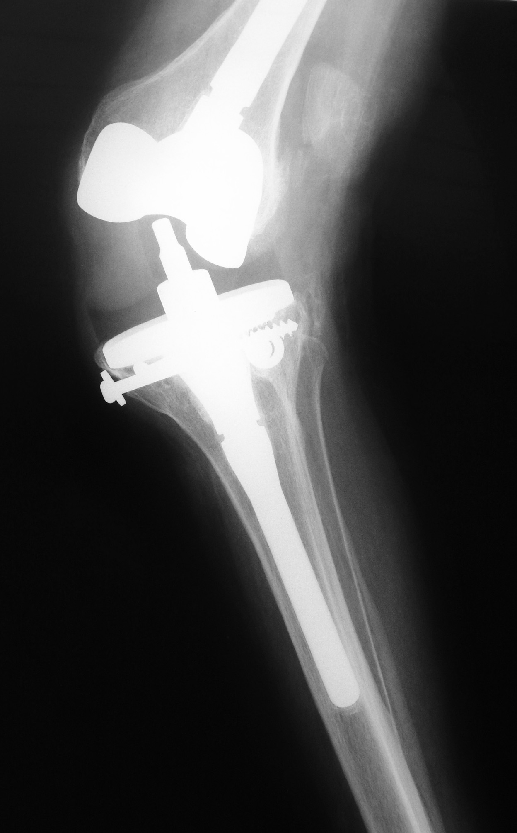
Rotatiós erők
felismerése
Megfelelő
constraint
2
10/11/2023

Slide 3
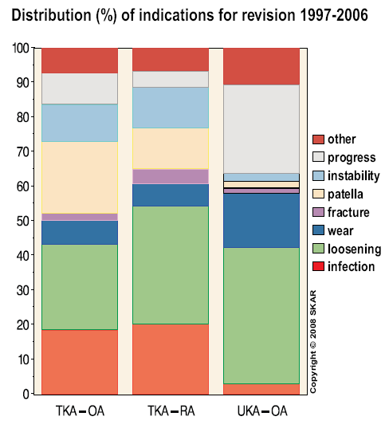
Malalignment 44 % Malrotation 61 % Instability 37 % Inadequate implant choice implant related, breakage 12 % Patella & ext / stiffness 5 % Infection, „loosening” EXCLUDE!!! 2 % Early loosening 27% ➔ combined 57% (84%) (surgeon) Uzsoki Hospital 2022 | 20 % infections 4 main aseptic failures ⇨ PE wear ⇨ loosening ⇨ instability ⇨ patella 50 % early (2 years) Sharkey et al, CORR 2002 63 % early (5 years) Fehring et al, CORR 2001
Swedish arthroplasty register
Annual report 2012

Slide 4
1: LAZULÁS, MALFUNCTIO MECHANIZMUS (elvárás, szövődmény ráta)
irodalom
Mont MA, Serna FK, Krackow KA, Hungerford DS. Exploration of radiographically normal total knee replacements for unexplained pain.
Clin Orthop Relat Res. 1996 Oct;(331):216-20.
2:TERVEZÉS
3: INFECTIO KIZÁRÁS
irodalom
Della Valle C, Parvizi J, Bauer TW, DiCesare et al. American Academy of
Orthopaedic Surgeons clinical practice guideline on: the diagnosis of periprosthetic joint infections of the hip and knee.
AAOS. J bone Joint Surg Am. 2011 Jul 20;93(14):1355-7
4: IMPLANTÁTUM, CONSTRAINT VÁLASZTÁS, MINIMÁL CONSTRAINT
Irodalom
Callaghan JJ, O'Rourke MR, Liu SS. The role of implant constraint in revision
Total knee arthroplasty: not too little, not too much.
J Arthroplasty. 2005 Jun;20(4 Suppl 2):41-3.
5: FELTÁRÁS, CSONTMEGTARTÁS, CSONTPÓTLÁS
irodalom
Zonnenberg CB, Lisowski LA, van den Bekerom MP, Nolte PA. Tuberositas
osteotomy for total knee arthroplasty: a review of the literature.
J Knee Surg. 2010 Sep;23(3):121-9.
Classification of bone defects by AORI considers condyle status (both femur and tibia)
Engh GA, Ammeen DJ. Bone loss with revision total knee arthroplasty: defect
classification and alternatives for reconstruction. Instr Course Lect. 1999;48:167-75
6:THREE STEP TECHNIQUE

Slide 5
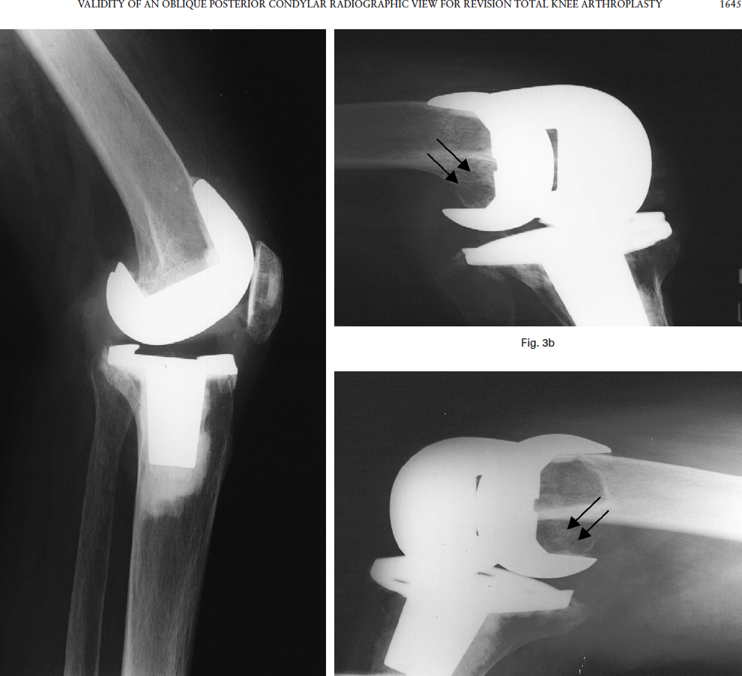
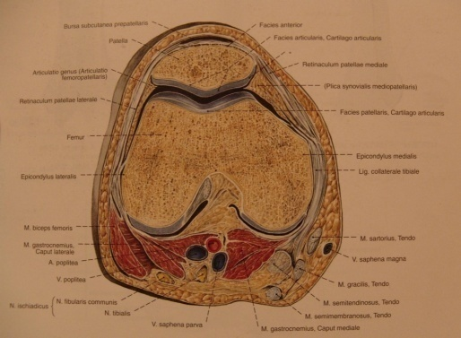
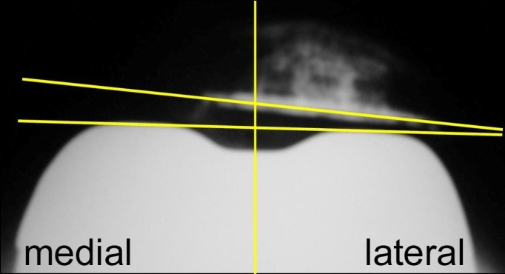
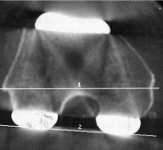
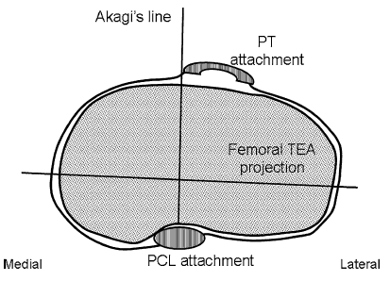
Implantátum positio & mechanikai tengely | Tengely & rotatio & flexiós stabilitás LDFA (90°) MPTA (90°) Jointline extensio-flexio IM correctiós szög | AP terhelt( hosszú ), Patella terhelt, CT Rotatio – Patella tracking, epicondylaris tengely & stabilitás flexióban ( Insall ) Méret AP/ML ( nem operált ellenoldali térd)
Csontpótlás algorythmus | Graft & augment, szár fixatio
Constraint | Izom, ligamentum balance – csontos & lágyrész
Standard Rtg felvételek
Képerősítő
Femur ferde oldal felv.
CT
Intraop. kedvezőtlenebb
Femur ferde betekintő
Miura, JBJS 2005
5

Slide 6
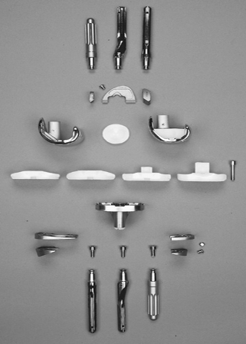
Constraint / Laxity & Stability J Biomechanics V 38/2 Haider&Walker | Unconstrained CR Semi-constrained PS Contemporary constrained Non-linked constrained CC Rotating-hinge RH 4. Fully constrained hinged 5. Segmental | CORR 2001 Nov Scuderi, Giles R. MD Revision Total Knee Arthroplasty: How Much Constraint is Enough? least degree of constraint.

Slide 7
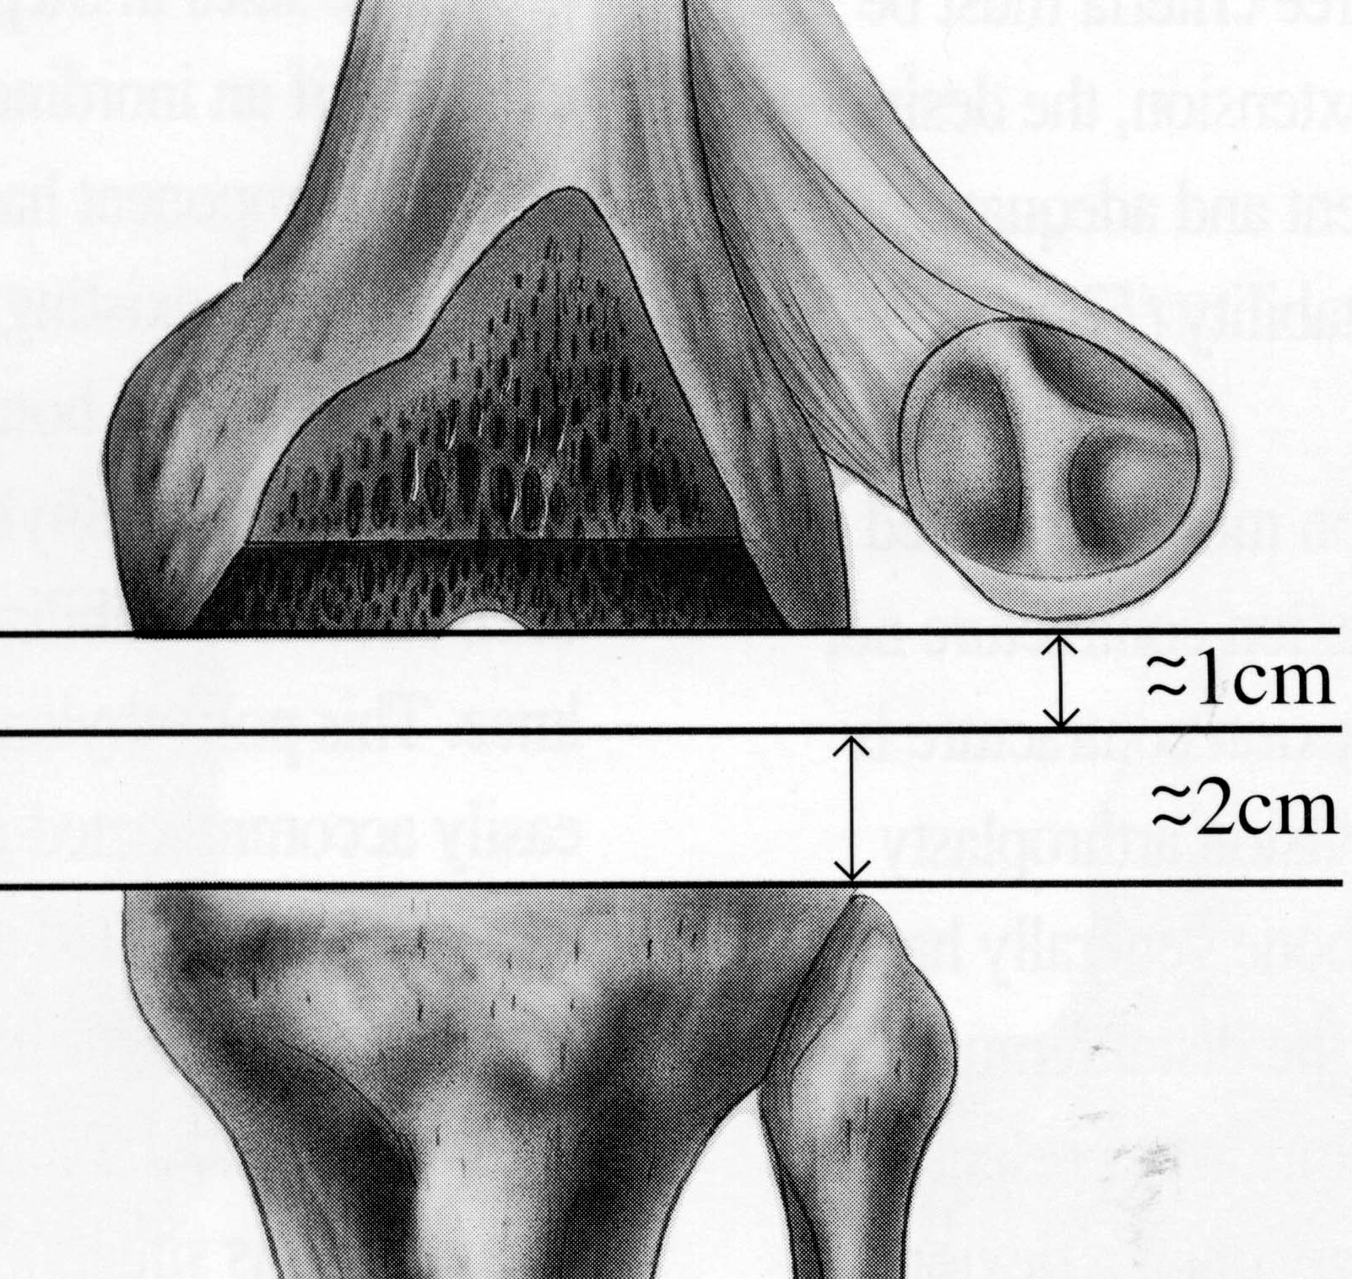
Joint line tervezés
Medial
Epicondyle
Kinematika
➔ magas patella - contractura
➔ alacsony patella - instabilitás
Joint line landmark
➔ 3 cm distalis – med. epicondylus
➔ 2 cm proximalis - fibula fej
➔ patella relatív
+ posterior joint line
Patella
Fibula
25-30 mm
Kelly Vince

Slide 8
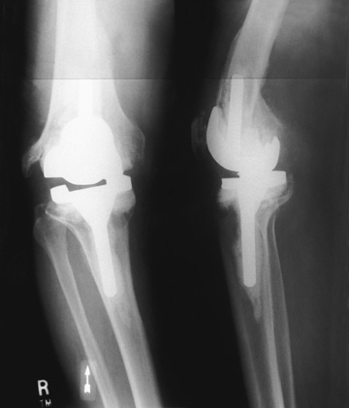
Csontvesztés etiologia
Post infectio
Csont destructio infectio során, mechanicai okok
Asepticus lazulás
Osteolysis
  Polyethylen particulum
  PMMA particulum
  Metallosis
Mechanicai overload
  Implantátum mal-alignment
  Lágyrész imbalance

Slide 9
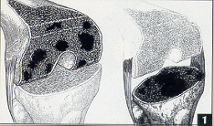
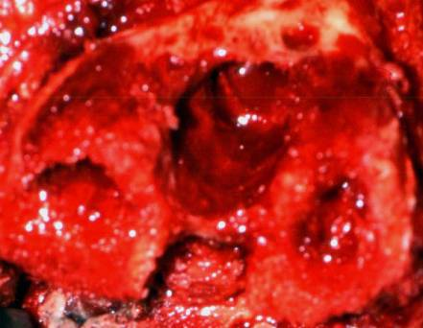
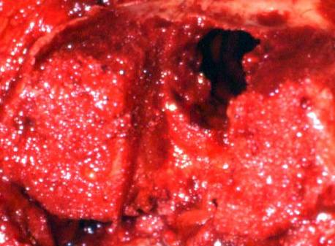
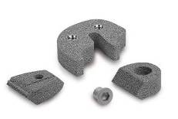
Csontdefectus classificatio
Type I Bone Defect
Type I Defectus
Megfelelő spongiosus csontfelszín megtartott metaphysealis segmentum
Csontgraft
Cement
Augmentum
Lucey S, Scuderi G, Kelly M, et al. A practical approach to dealing with bone loss in revision total knee arthroplasty. November. 2000, 3-6. Anderson Orthopaedic Research Institute (AORI) Defect Classification.

Slide 10
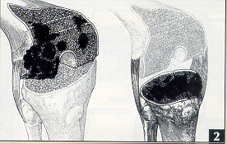
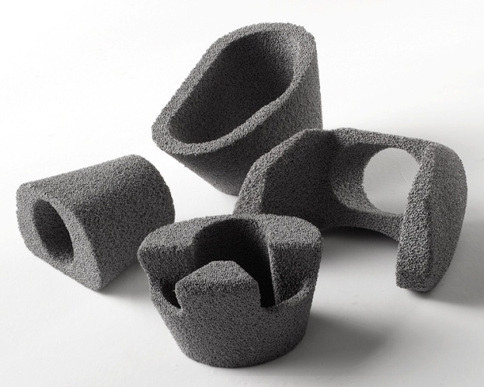
Csontdefectus classificatio
Type II Defectus
Metaphysealis segmentum rövidült
Augmentum:
Full Block
Half block
Wedge
Distal/Post/Ant
Femoralis Cone
Tibialis Cone
Lucey S, Scuderi G, Kelly M, et al. A practical approach to dealing with bone loss in revision total knee arthroplasty. November. 2000, 3-6. Anderson Orthopaedic Research Institute (AORI) Defect Classification.

Slide 11
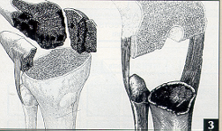
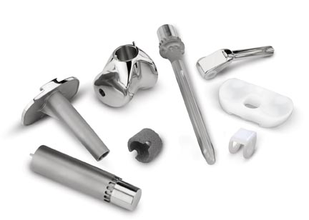
Csontdefectus classificatio
Type III Defectus
Metaphysealis segmentum deficientia epicondylus és tub. tibiae szintben
Femoralis Cone
Tibialis Cone
Segmentalis rendszer
Lucey S, Scuderi G, Kelly M, et al. A practical approach to dealing with bone loss in revision total knee arthroplasty. November. 2000, 3-6. Anderson Orthopaedic Research Institute (AORI) Defect Classification.

Slide 12
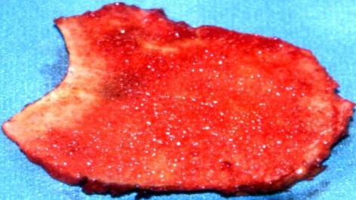
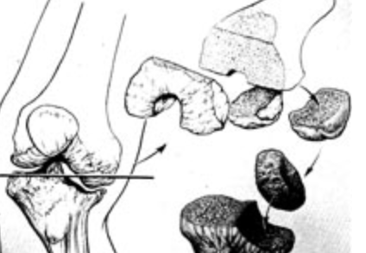
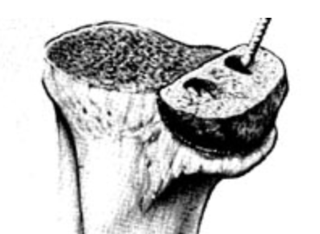
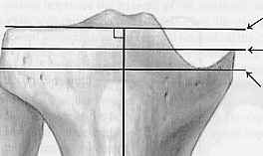
Structuralis Graft – Tibia
Femur – rögzítés ?
Autolog
Segmentalis defectus
fiatal beteg
Autolog graft
⇨ step cut
Homolog csont
⇨ combfej
⇨ structuralis graft
Step cut
Autograft femur

Slide 13
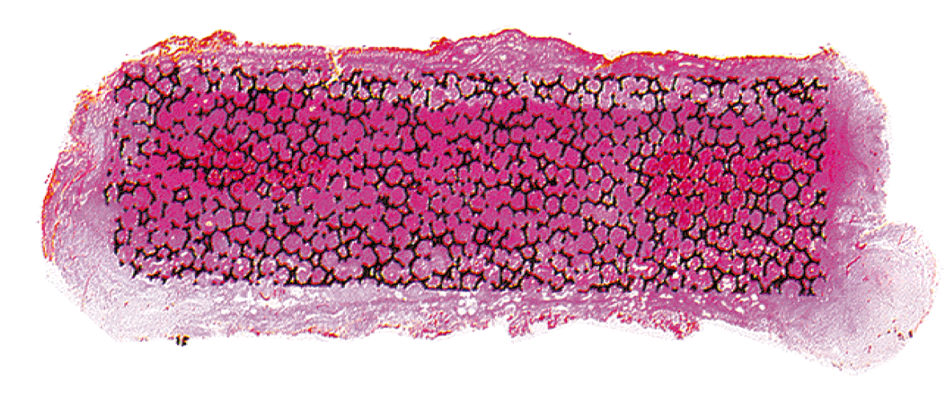
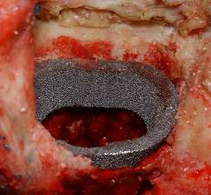
Tantalum, Trabecular Metal Augmentumok
Trabecular Metal :
Cavitaris, segmentalis csont defectus
  “metal bone graft”
  Mind cementes, mind cementnélküli rögzítés
Endostealis cavitás erősítés élő csont megtartása mellett
Supportiv - tibia
Rotatiós stabilitás - femur
Hacking SA, Bobyn JD, Toh K-K, et. al. Fibrous tissue ingrowth and attachment to porous tantalum. J Biomed Mater Res. 2000; 52:631-638

Slide 14
Can Tantalum Cones Provide Fixation in
Complex Revision Knee Arthroplasty?
Lachiewicz PF, Bolognesi MP, Henderson RA, Soileau ES, Vail TP. Can Tantalum Cones Provide Fixation in Complex Revision Knee Arthroplasty? Clin Orthop Relat Res. 2011 Apr 5.
27 patients, retrospective review (out of 33)
13x infection, 10x aseptic loosening, 4x wear osteolysis
“Osteointegration of the tantalum metaphyseal cones, …, was noted in 26 patients (31 cones [94%]) at last follow-up”
“our study suggests the use of tantalum cones for large structural defects in revision TKA is a promising technique with a low rate of infection and component loosening”
However longer follow-up and larger studies are needed

Slide 15
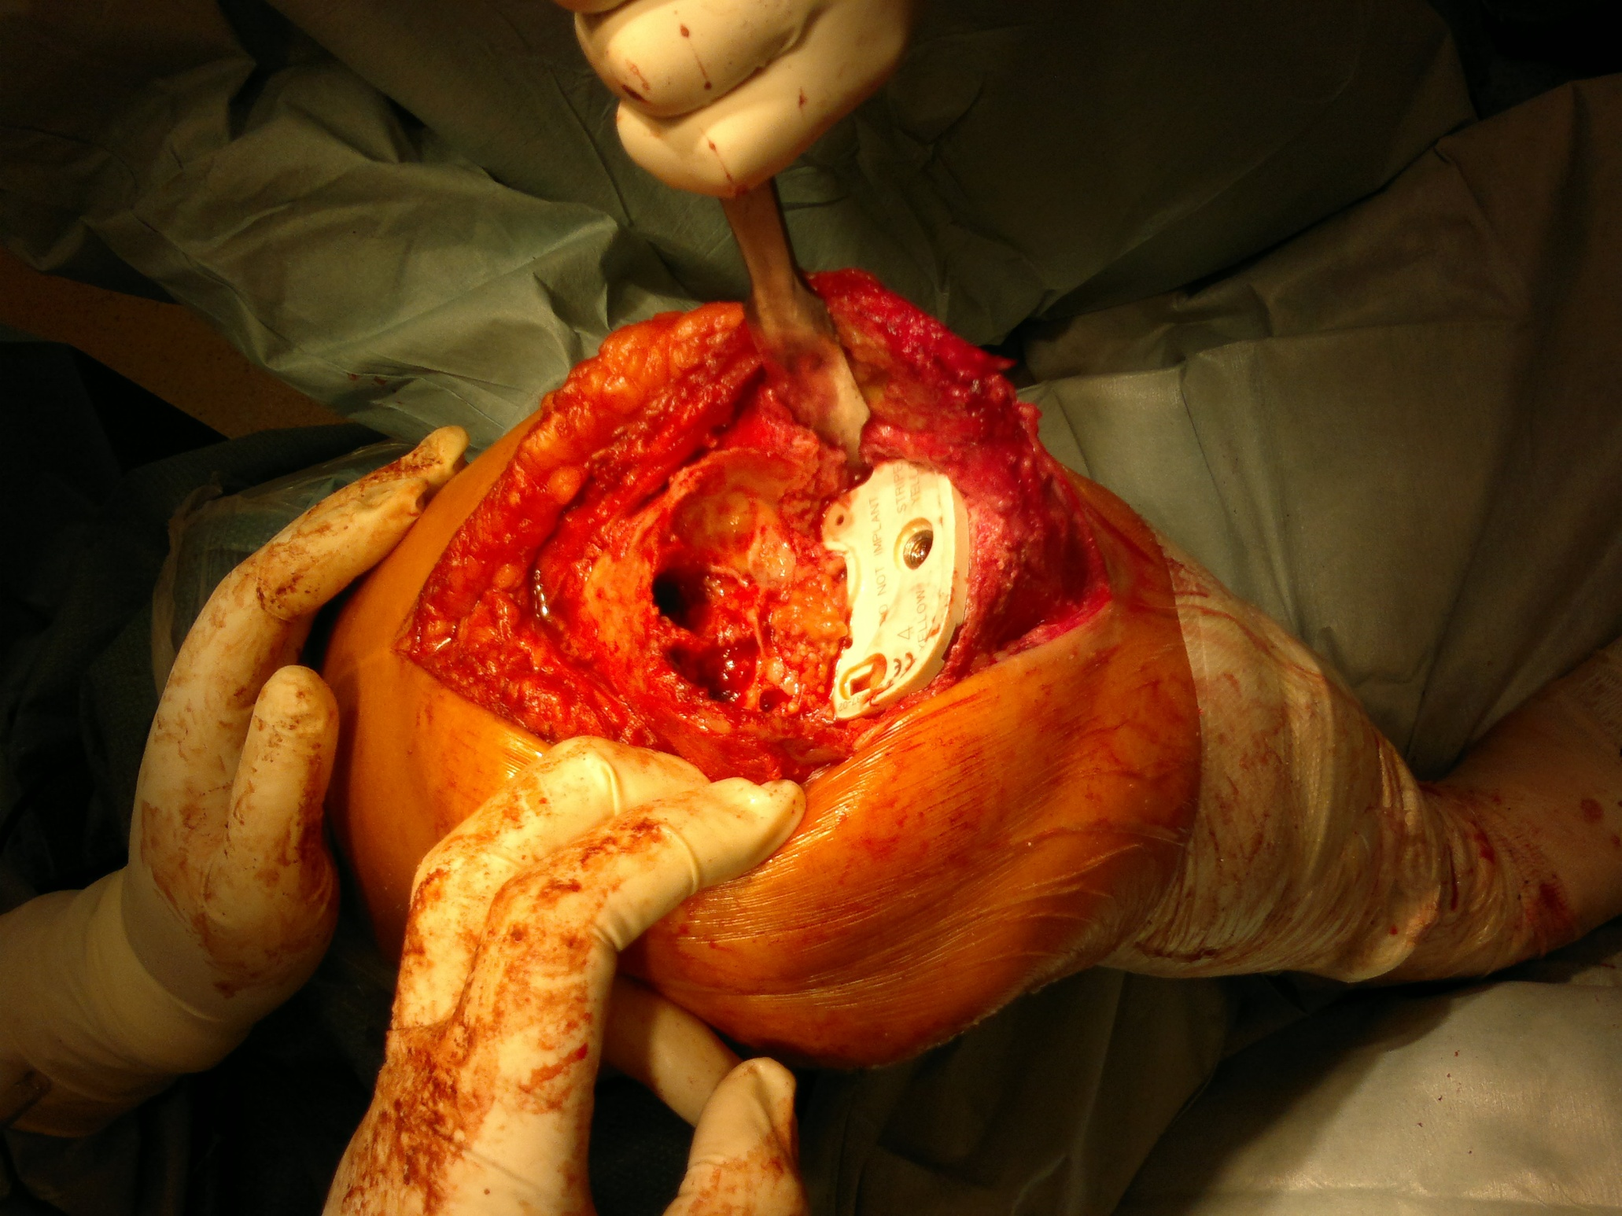
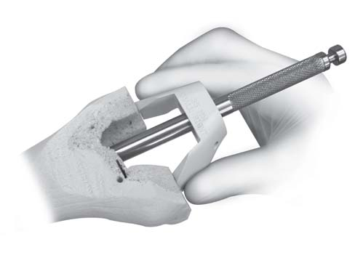
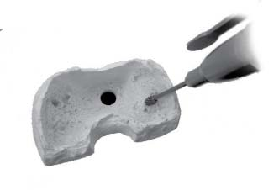
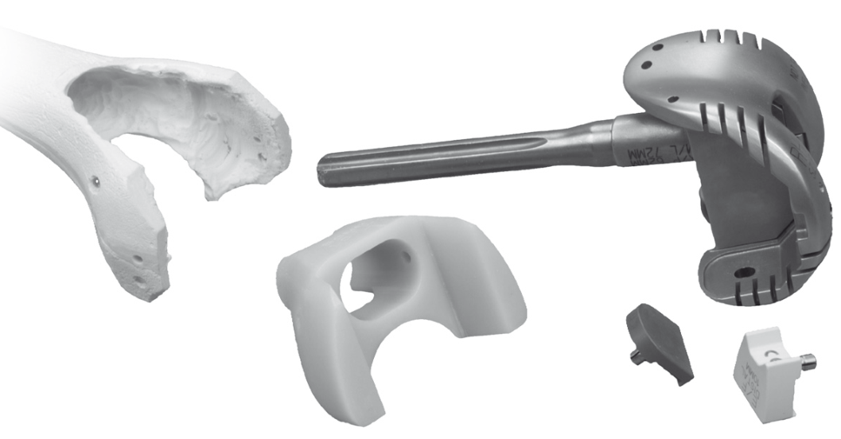
Min. 5 mm boxmélység
Csontminőség
Multiplex block technika
Rotációstabilitás

Slide 16
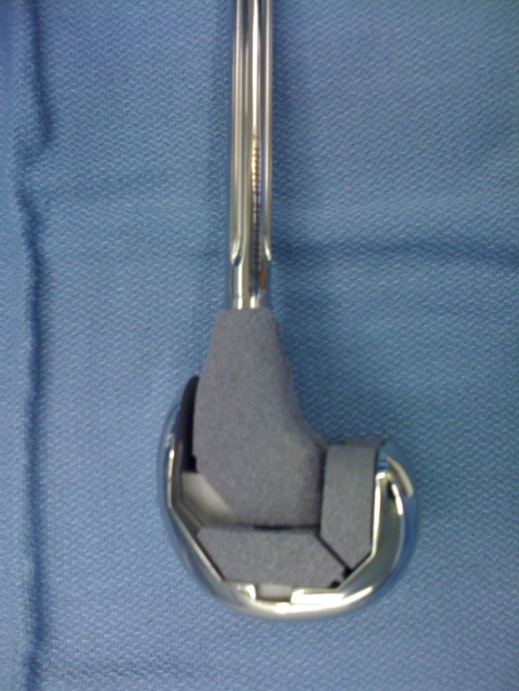
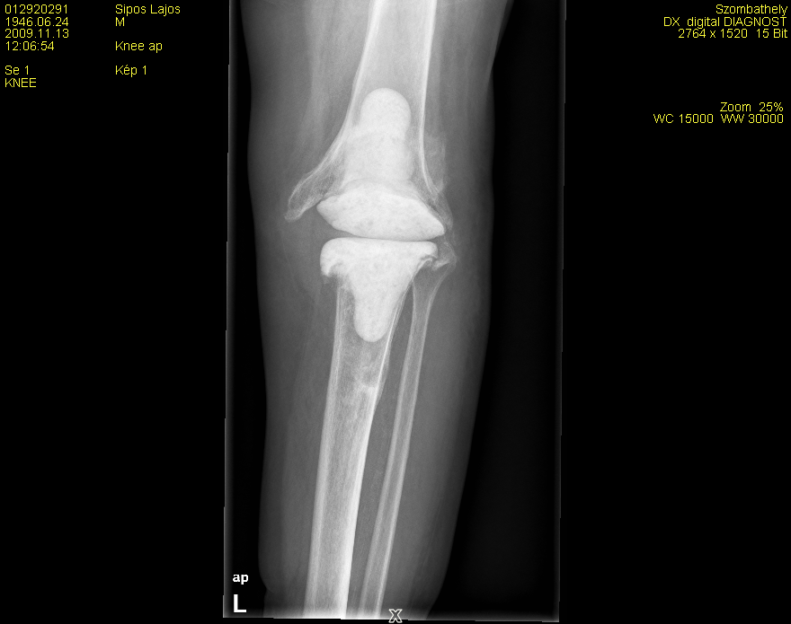
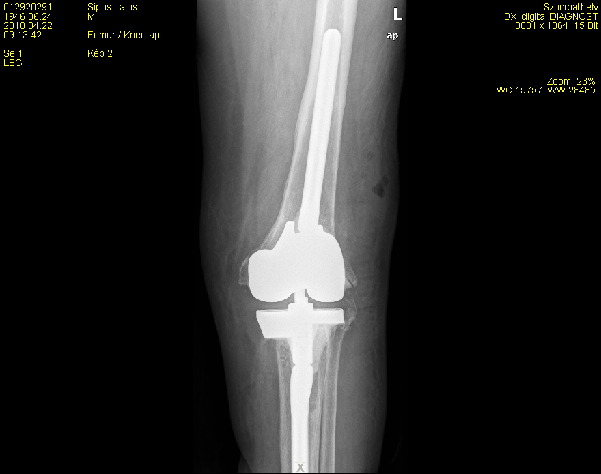
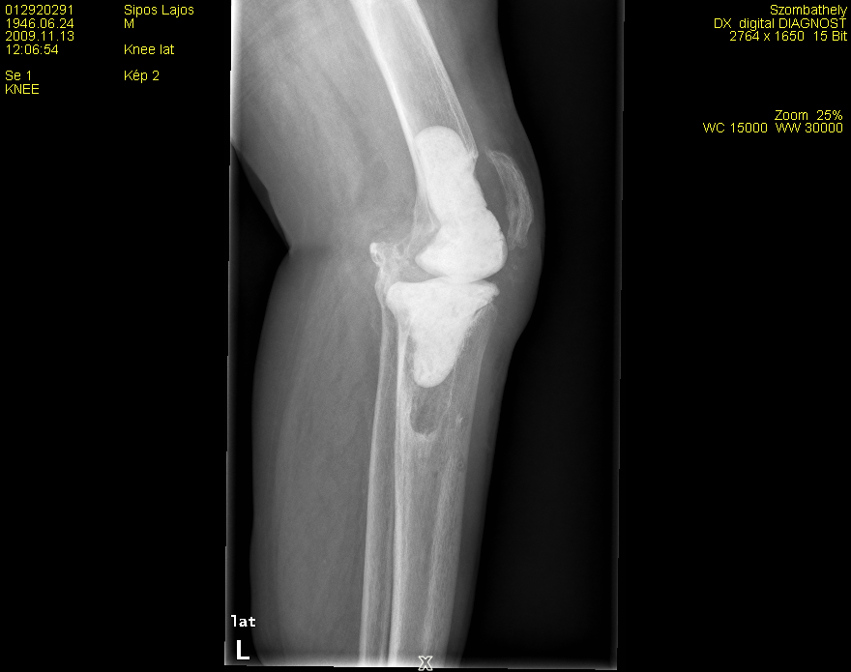
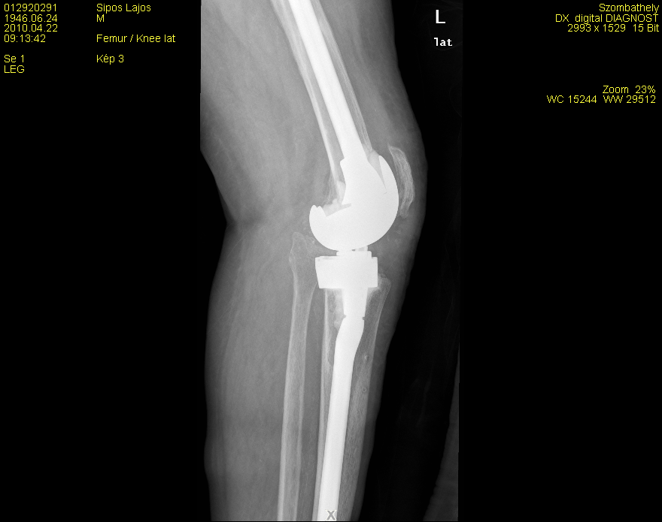
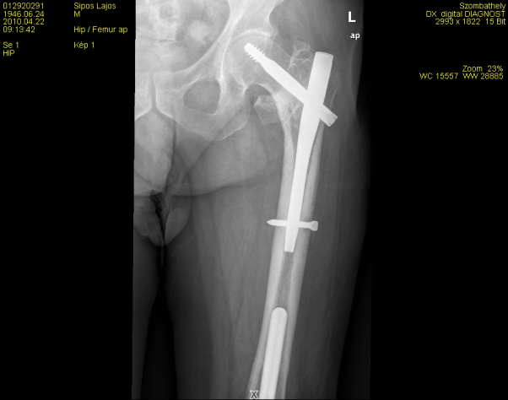
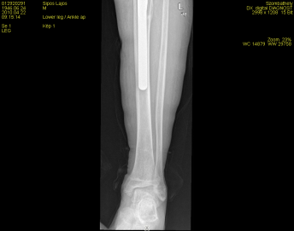
Femur defect+
balance

Slide 17
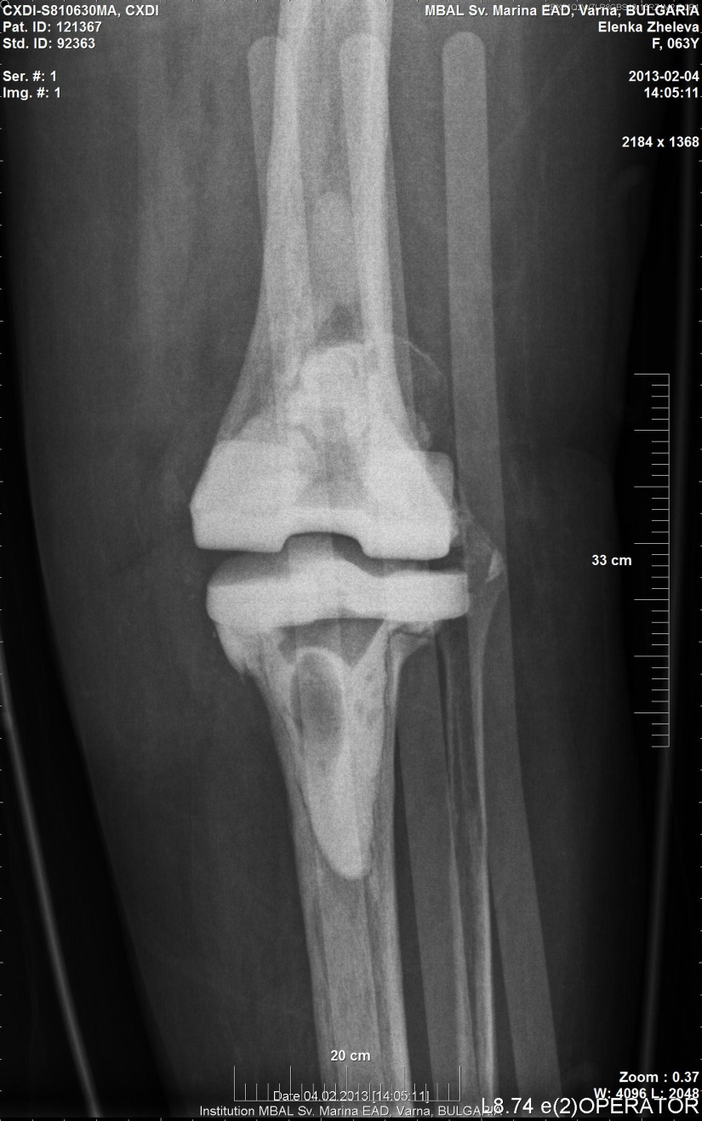
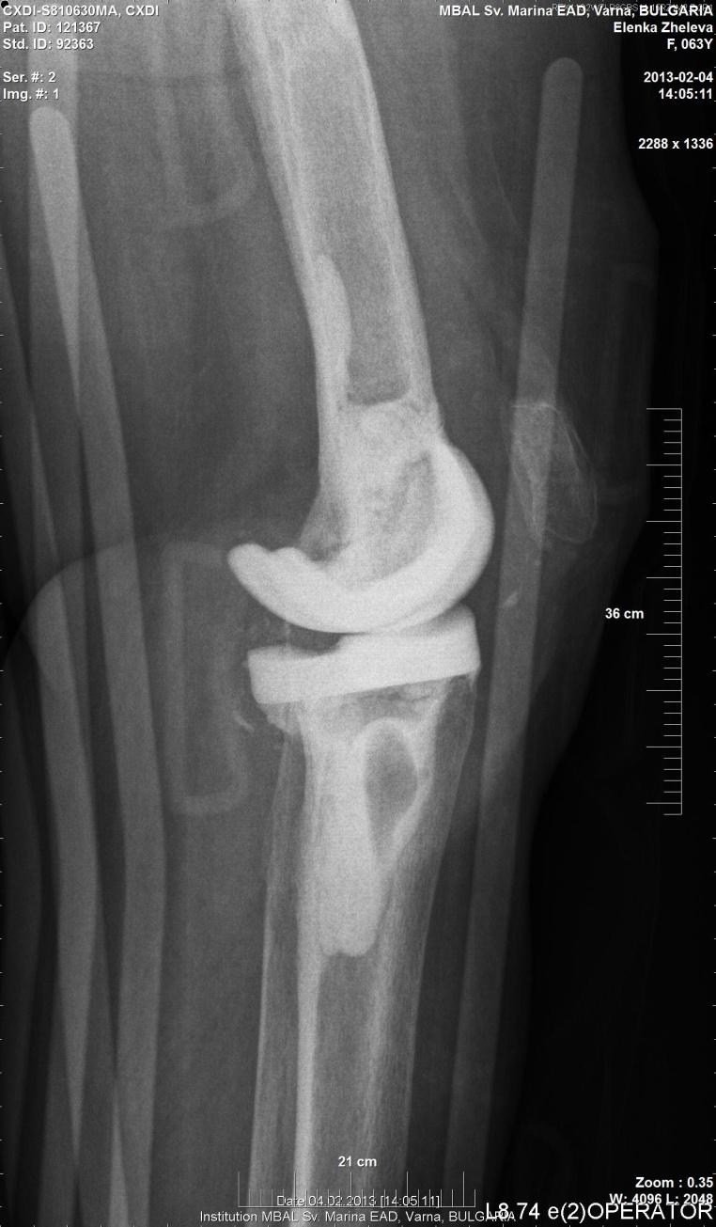
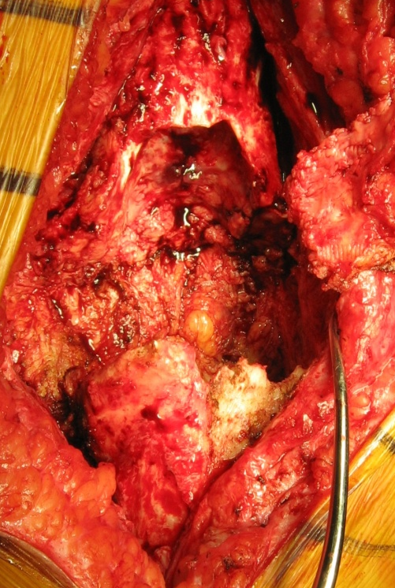
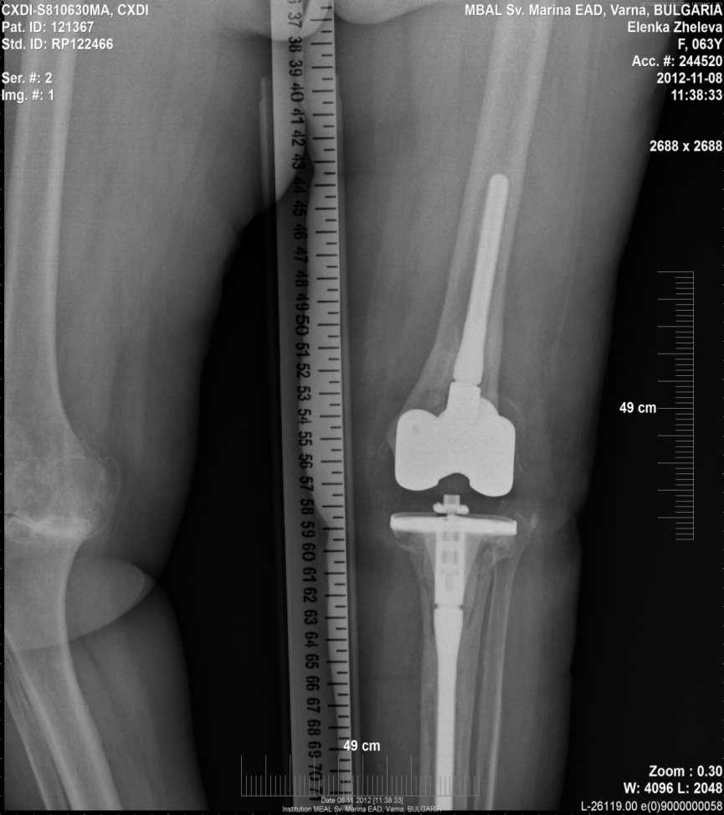

Slide 18
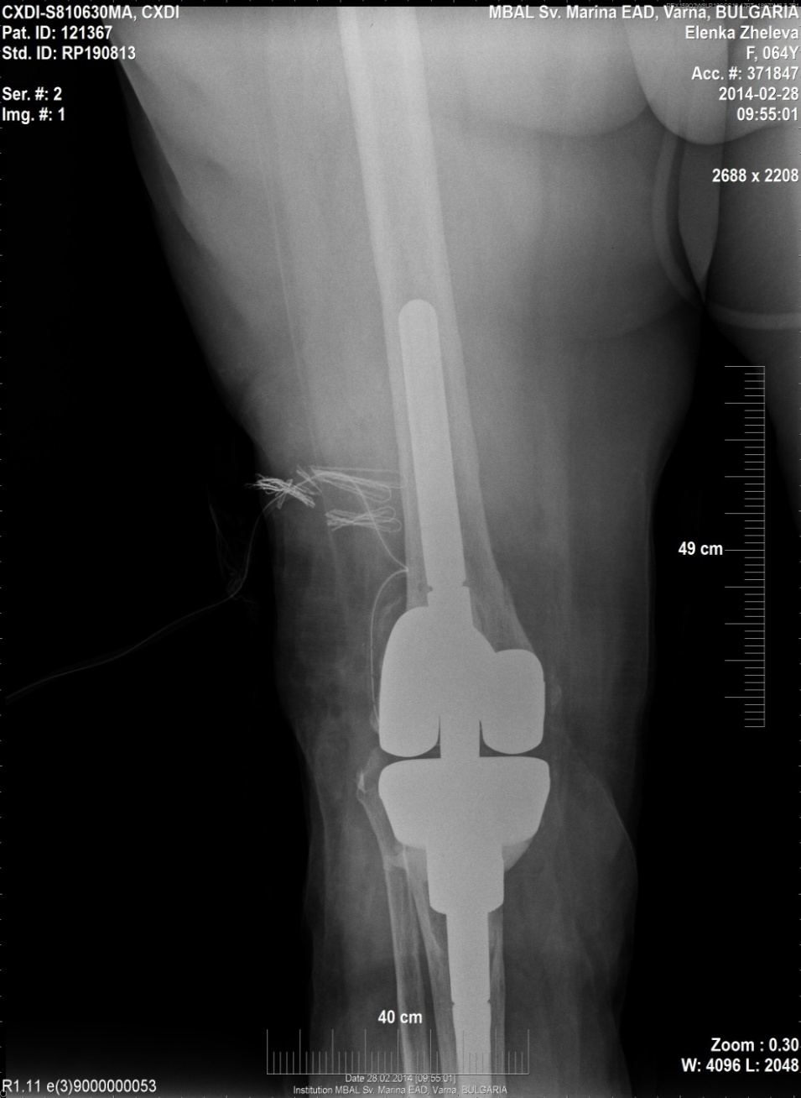
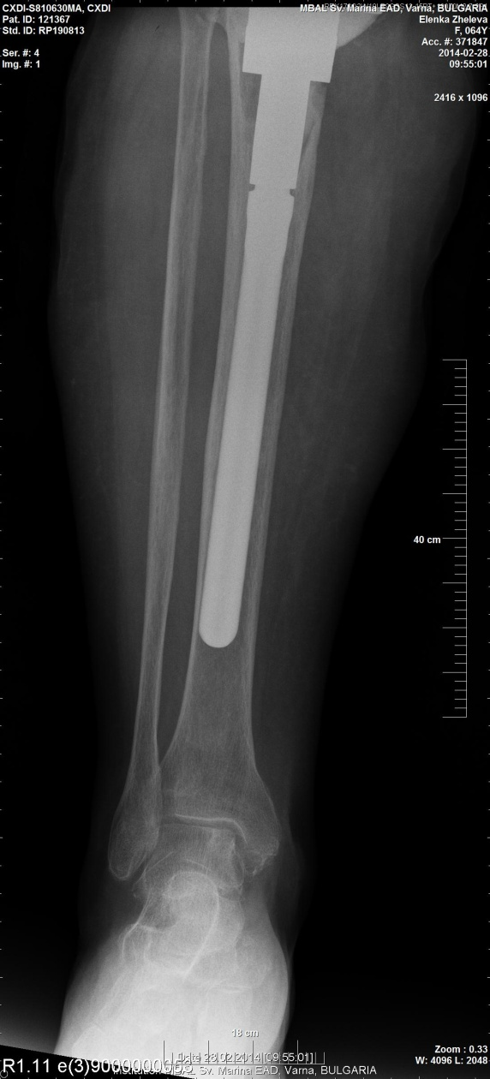
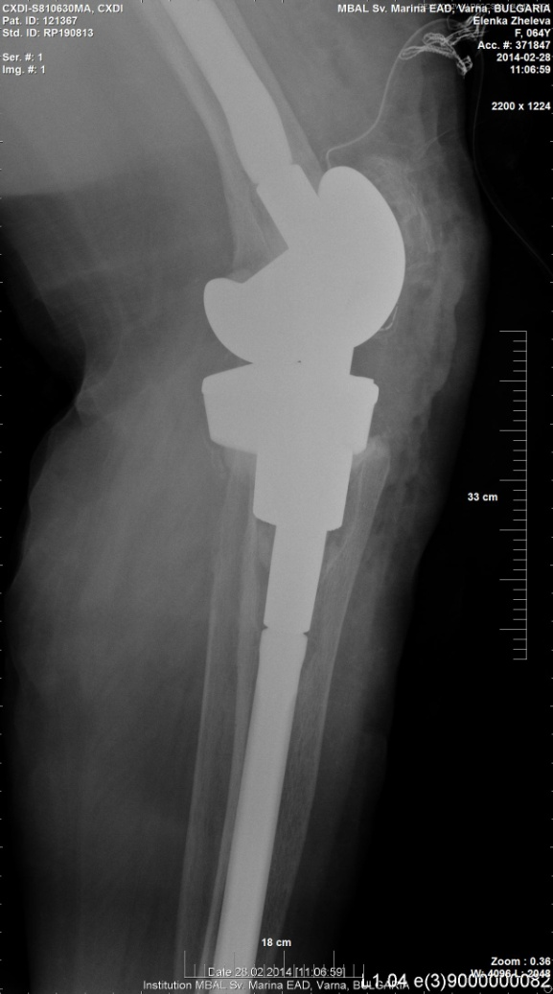
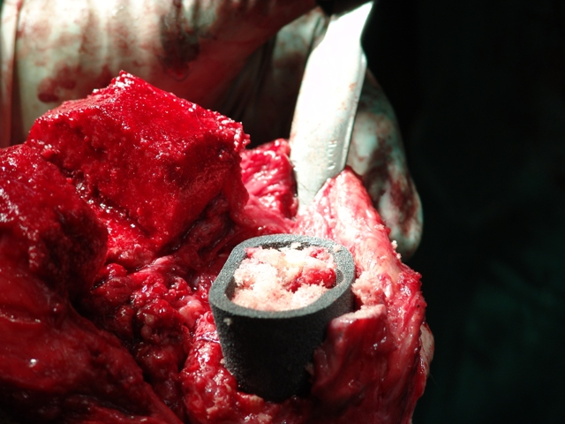

Slide 19
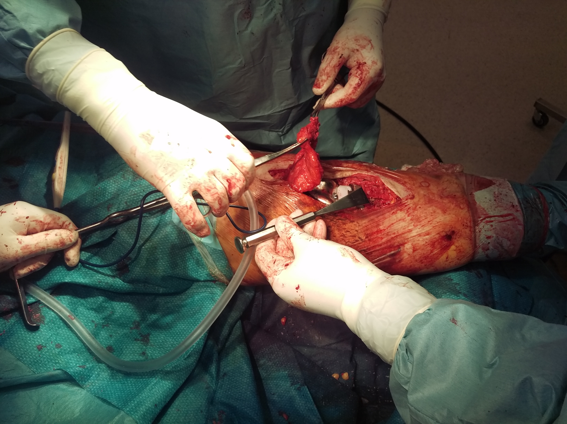
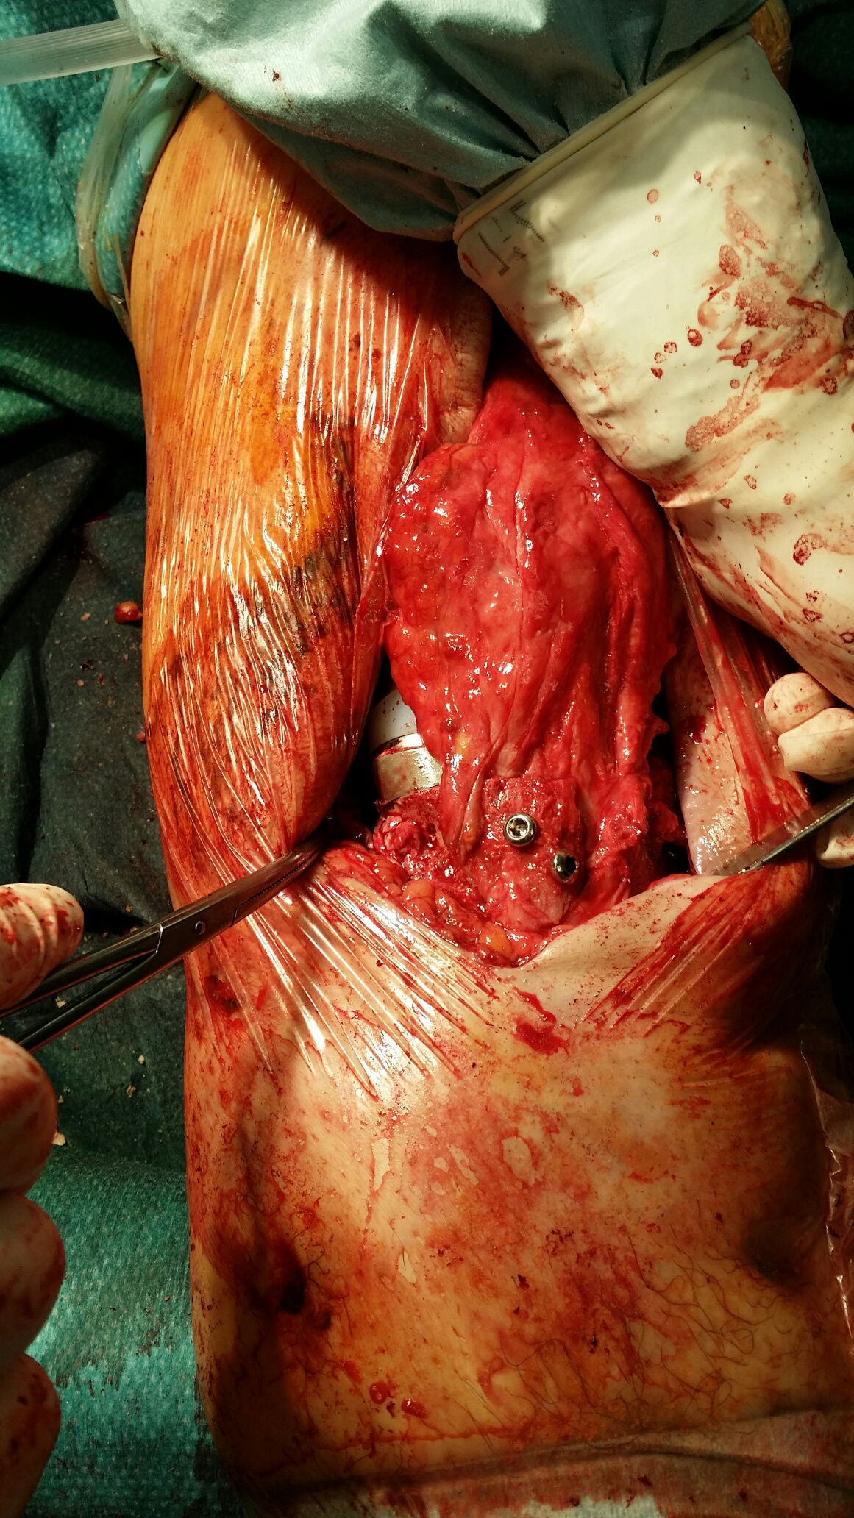
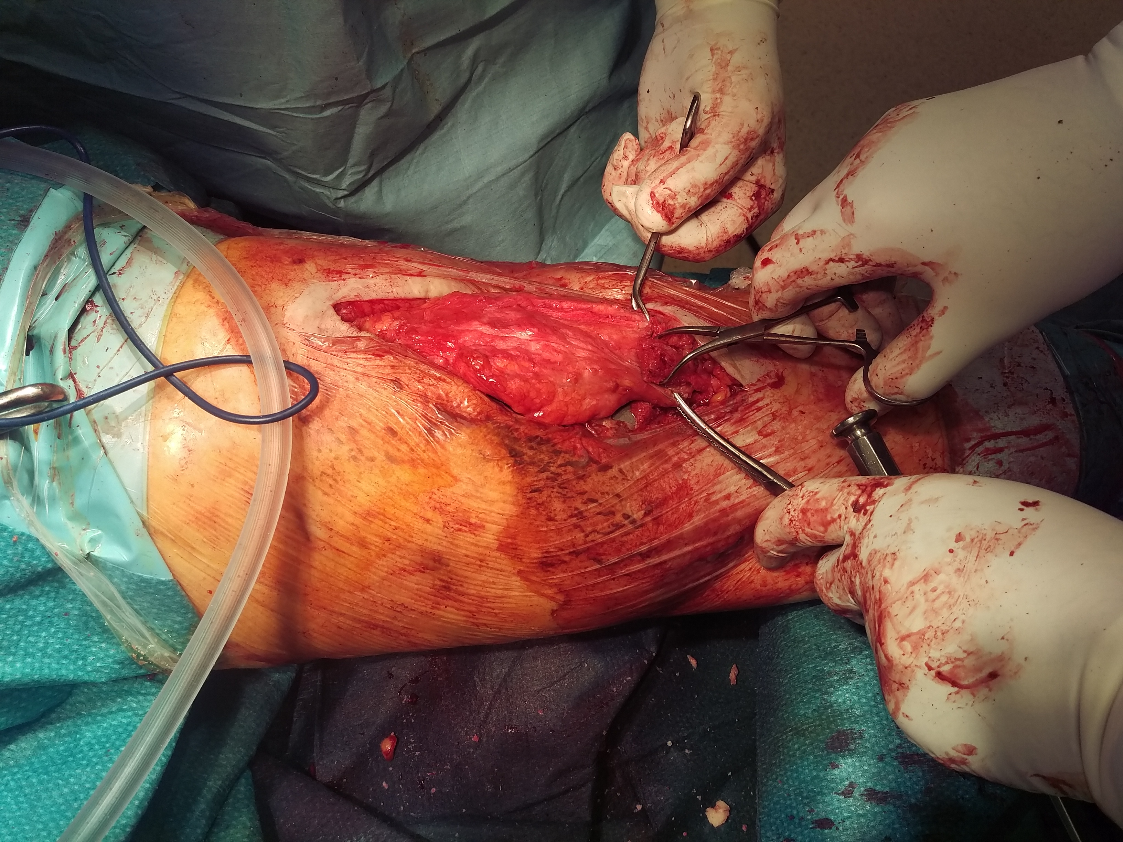
Tub. Tibiae reconstructio
19

Slide 20
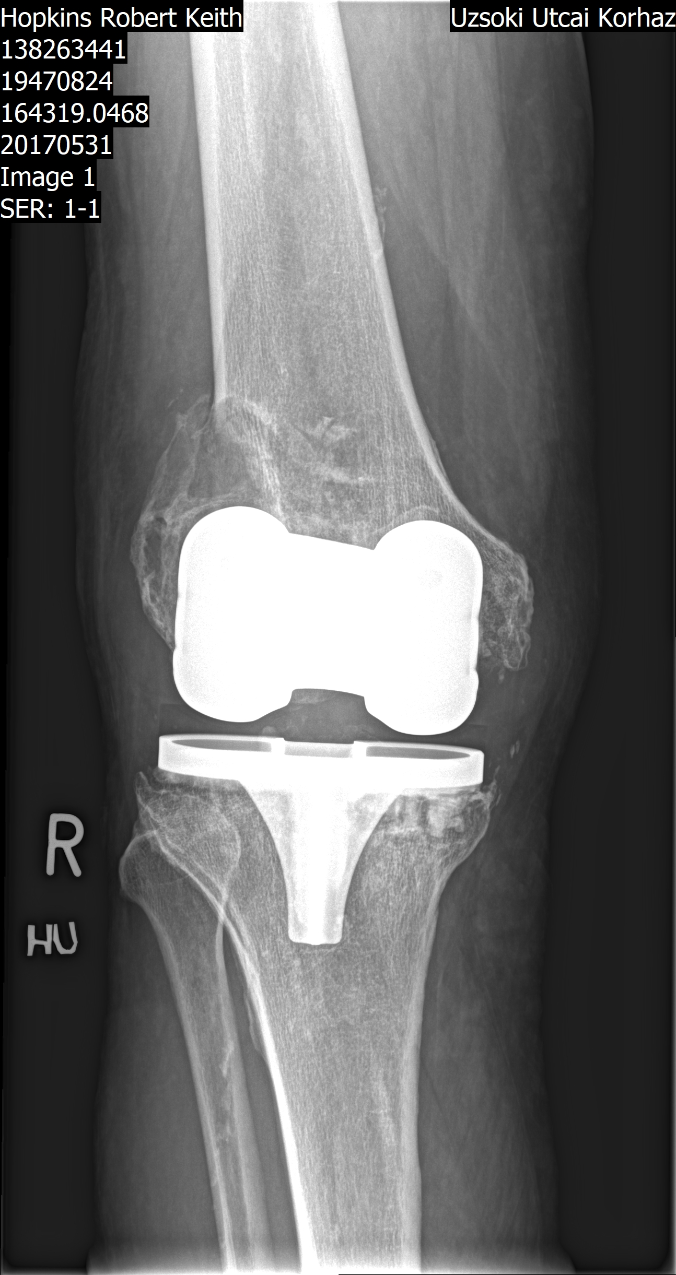
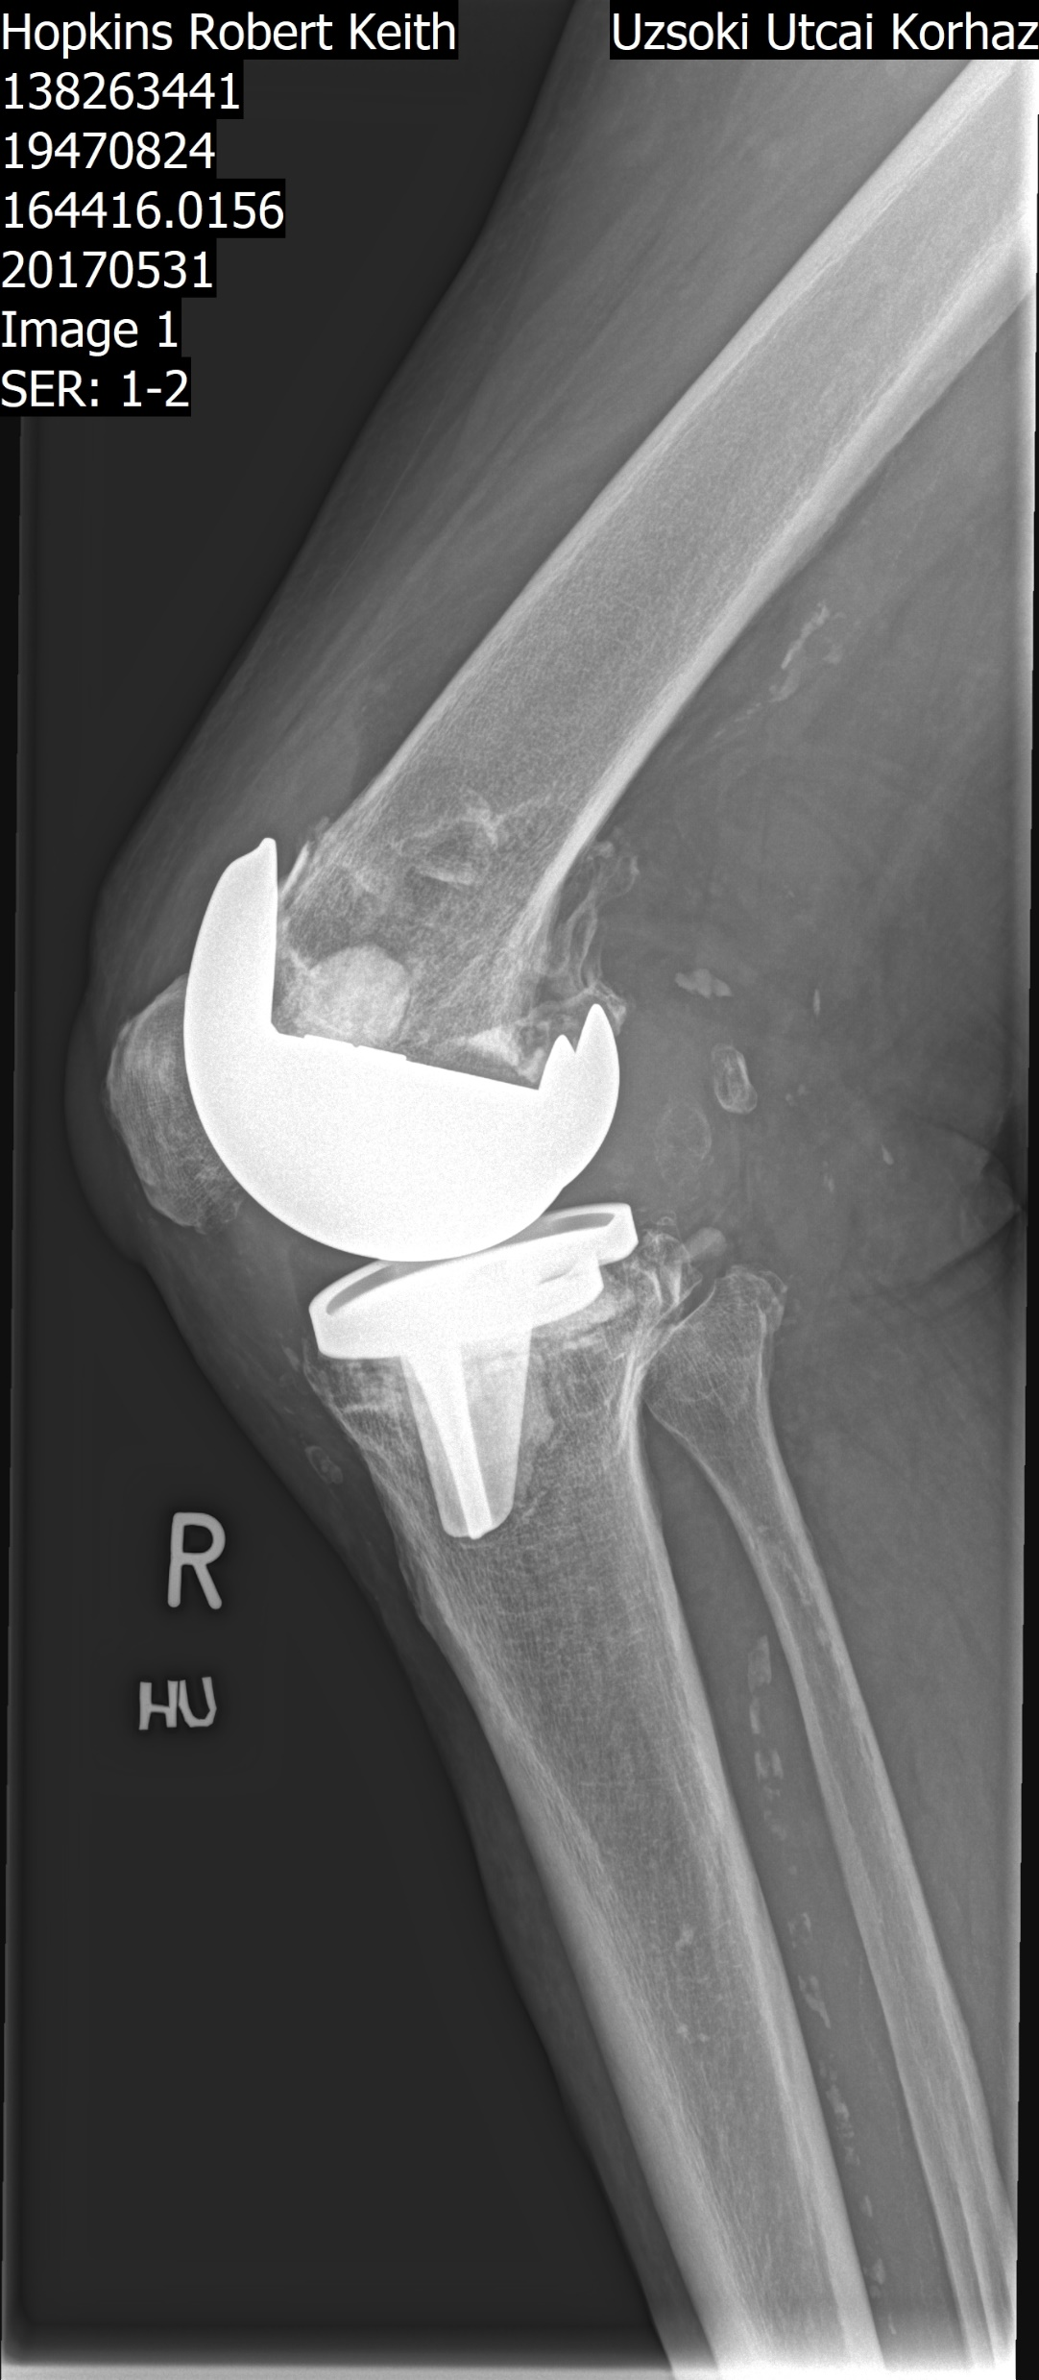
AORI III

Slide 21

AORI III, intraop.
lat.cond.destructio

Slide 22



AORI III, kombinált, biológiai+augment

Slide 23



AORI III, constraint

Slide 24




Rorabeck III szögstabil synthesis +ASP
Resorptio, instabilitás
24
10/11/2023

Slide 25






Segmentalis spacer CR
Segmentalis revisio II. lépés
Orthesis - stabilitás

Slide 26



AORI III, constraint, „semi segmentalis”

Slide 27





AORI III, constraint,
Multiple „semi segmental”

Slide 28





Slide 29











Type I varus | lig. release | CR/PS
Type II varus | instability,lig. release, rotation | PS/CC/RH
Type III varus | bony release | CR/PS
Valgus |  | PS/CC/RH

Slide 30











Trauma, periprosthetic fracture | PS
Posttrauma extraarticular deformity (chronic) | PS
Posttrauma ligamentous (chronic) | RH(CC)
30
10/11/2023

Slide 31














Revision post infection Unbalanced rotation Anterior spike | RH
Revision post infection Balanced rotation | CC
Revision sign.defect | RH
31
10/11/2023

Slide 32
1./ Are Trabecular Metal Cones a Valid Option to Treat Metaphyseal Bone Defects in Complex Primary and Revision Knee Arthroplasty? Tommaso Bonanzinga, Thorsten Gehrke, Akos Zahar, Stefano Zaffagnini, Maurilio Marcacci, Carl Haasper
Conclusion The TM cones are an effective solution to manage bone defects in complex primary and revision TKA at intermediate follow-up. The incidence of complications was low; however, the femoral metaphysis proved to be more susceptible to complications.
2./ Usefulness of Trabecular Metal Cones in Revision Total Knee Arthroplasty in a Korean Population
Ji-Hoon Baek, Orthop res.rev.2022; 14: 199–206.
The present study of trabecular metal cones demonstrates excellent clinical outcomes and survivorship in revision TKA during medium-term follow-up periods. However, longer-term follow-up studies are needed to further investigate these implants in revision TKA. Additionally, the necessity of metal cones in revision procedures should be carefully considered depending on patient needs and economic capabilities.
3./ Knee Society Proceedings 2016 Nemandra A. Sandiford, Donald S. Garbuz, Bassam A Masri
No Difference Between Trabecular Metal Cones and Femoral Head Allografts in Revision TKA: Minimum 5-year Followup

Slide 33
2009 December-2022 December | 297 beteg AORI II-III | Átlegéletkor 69 év Utánkövetés 3-72 hó
Femur TM | 51
Tibia TM | 47
Significans csonthiány, instabilitás | 210
PS | 67
CC | 91
RH | 139 (6 segmentalis )
KSKS | 171(constraint, pótlás fokától független)
ROM | 30- 90° preop, post op 2: 75° @ 3 mos 100° , @ 6 mos 110°
Szövődmény | 3 re-infectio
Fájdalom skála | VAS pre op. Ø 7.5 p. op. 10 nap :2,2

Slide 34
MOT PROTÉZIS KEREKASZTAL
A térdprotézisek aktuális kérdései BEK Akadémia
Budapest, 2023.11.11.
Preoperativ tervezés,
worst case scenario
Tengelycorrectio,stabilitás reconstructio, szalagegyensúly
Anatomiai structurák felhasználása
Extraarticularis deformitások figyelembe vétele
Constraint, augmentumok elérhetősége
Köszönöm a figyelmet!

